Slide 1
Security Goals
Confidentiality:
The degree of confidentiality determines the secrecy of the information. The principle specifies that only the sender and receiver will be able to access the information shared between them. Confidentiality compromises if an unauthorized person is able to access a message. For example, let us consider sender A wants to share some confidential information with receiver B and the information gets intercepted by the attacker C. Now the confidential information is in the hands of an intruder C.
Authentication:
Authentication is the mechanism to identify the user or system or the entity. It ensures the identity of the person trying to access the information. The authentication is mostly secured by using username and password. The authorized person whose identity is preregistered can prove his/her identity and can access the sensitive information.
Integrity:
Integrity gives the assurance that the information received is exact and accurate. If the content of the message is changed after the sender sends it but before reaching the intended receiver, then it is said that the integrity of the message is lost.

Slide 2
Non-Repudiation:
Non-repudiation is a mechanism that prevents the denial of the message content sent through a network. In some cases the sender sends the message and later denies it. But the non-repudiation does not allow the sender to refuse the receiver.
Access control:
The principle of access control is determined by role management and rule management. Role management determines who should access the data while rule management determines up to what extent one can access the data. The information displayed is dependent on the person who is accessing it.
Availability:
The principle of availability states that the resources will be available to authorize party at all times. Information will not be useful if it is not available to be accessed. Systems should have sufficient availability of information to satisfy the user request.

Slide 3
Cryptography
Cryptography
The field of study related to encoded information (comes from Greek word for "secret writing")
Encryption
The process of converting plaintext into ciphertext
Decryption
The process of converting ciphertext into plaintext

Slide 4
Cryptography
Encryption
plaintext
message
ciphertext
message
Decryption
Encrypted(Information) cannot be read
Decrypted(Encrypted(Information)) can be

Slide 5
Cryptography
Cipher
An algorithm used to encrypt and decrypt text
Key
The set of parameters that guide a cipher
Neither is any good without the other

Slide 6
Substitution Ciphers
A cipher that substitutes one character with another.
These can be as simple as swapping a list, or can be based on more complex rules.
These are NOT secure anymore, but they used to be quite common. What has changed?

Slide 7
Symmetric and Asymmetric Encryption

Slide 8
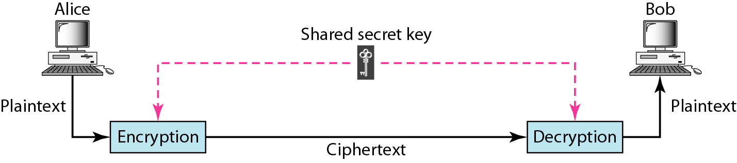
Symmetric-key cryptography
30.<number>

Slide 9

Note
In symmetric-key cryptography, the same key is used by the sender(for encryption) and the receiver (for decryption).
The key is shared.
Algorithm: DES,3DES
30.<number>

Slide 10
Symmetric-key cryptography
Advantages:
  Simple
  Faster
Disadvantages:
  Key must exchanges in secure way
  Easy for hacker to get a key as it is passed in unsecure way.

Slide 11
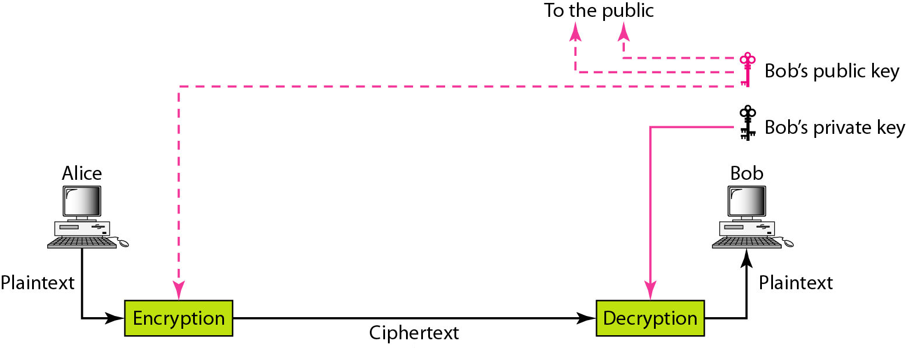
Figure 30.4 Asymmetric-key cryptography
30.<number>

Slide 12
Note
An asymmetric-key (or public-key) cipher uses two keys: one private (To encrypt data) and one public(To decrypt data).
30.<number>

Slide 13
Asymmetric Key Cryptography (Public Key Cryptography)
  2 different keys are used
  Users get the Key from an Certificate Authority
  Advantages
  More Secured
  Authentication
  Disadvantages
  Relatively Complex

Slide 14
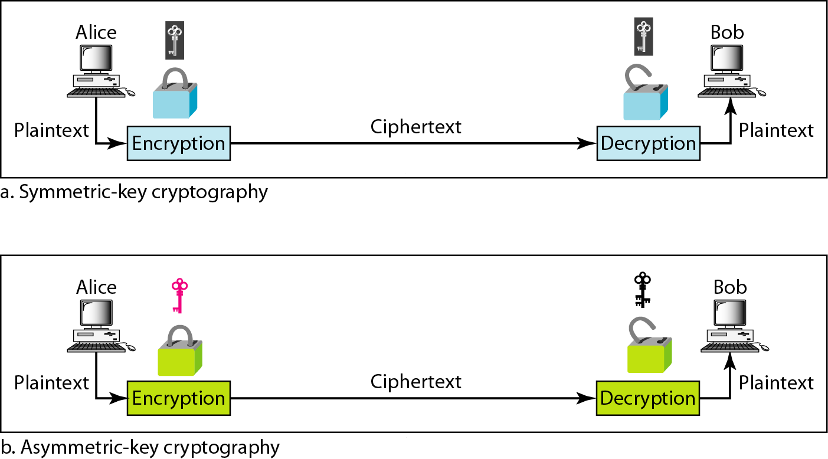
Figure 30.6 Comparison between two categories of cryptography
30.<number>

Slide 15

Asymmetric encryption use two keys, one to encrypt the data, and another key to decrypt the data.
These keys are generated together
. One is named as Public key and is distributed freely. The other is named as Private Key and it is kept hidden.
Both Sender & Recipient has to share their Public Keys for Encryption and has to use their Private Keys for Decryption.

Slide 16

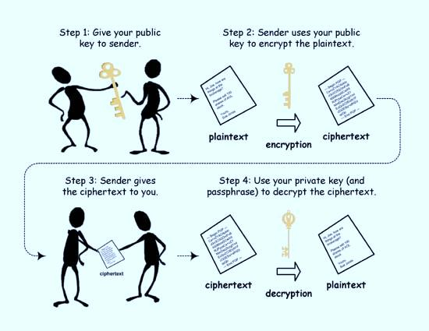

Slide 17
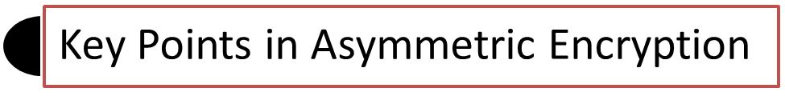
Asymmetric encryption use two keys:
Public Key - to encrypt the data
Private Key - to decrypt the data
These keys are generated together.
The Public key(s) is distributed freely between the sender and receiver.
The other is named as Private Key and it is kept hidden.
The Private Key is only used for Decryption and will not be shared between the sender and receiver.

Slide 18

RSA:
Digital Signature Algorithm:
Diffie-Helman:.
© 2013, Triad Square InfoSec Pvt. Ltd

Slide 19

Merits:
Two parties don't need to have their private keys already shared in order to communicate using encryption.
Authentication and Non-Repudiation are possible. (Authentication means that you can encrypt the message with my public key and only I can decrypt it with my private key. Non-repudiation means that you can "sign" the message with your private key and I can verify that it came from you with your public key.)
De-Merits:
Asymmetric Encryption algorithms are comparatively complex.
Time consuming process for Encryption and Decryption.
© 2013, Triad Square InfoSec Pvt. Ltd

Slide 20
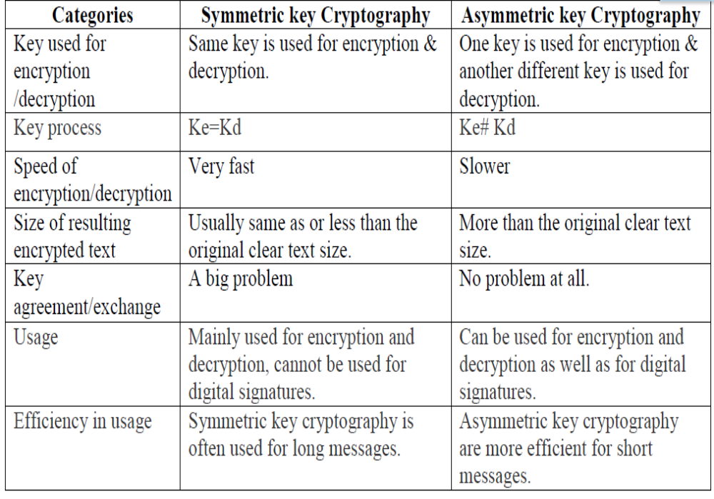
For more detail contact us

